Slide 1

OWASP Switzerland
Community Meetup
February 19th, 2025
Sven Vetsch, Patrick Steger, Manuel Walder, Federico Casano
OWASP Switzerland Leader Team
www.owasp.org

Slide 2
INTRODUCTION TO OWASP
The Open Worldwide Application Security Project (OWASP) is a nonprofit foundation that works to improve the security of software.
Community-led open source projects including code, documentation, and standards
Over 250+ local chapters worldwide
Tens of thousands of members
Industry-leading educational and training conferences

Slide 3



Core Values
Open
Innovative
Global
Integrity
Everything at OWASP is radically transparent from our finances to our code.
We encourage and support innovation and experiments for solutions to software security challenges.
Anyone around the world is encouraged to participate in the OWASP community.
Our community is respectful, supportive, truthful, and vendor neutral.

Slide 4
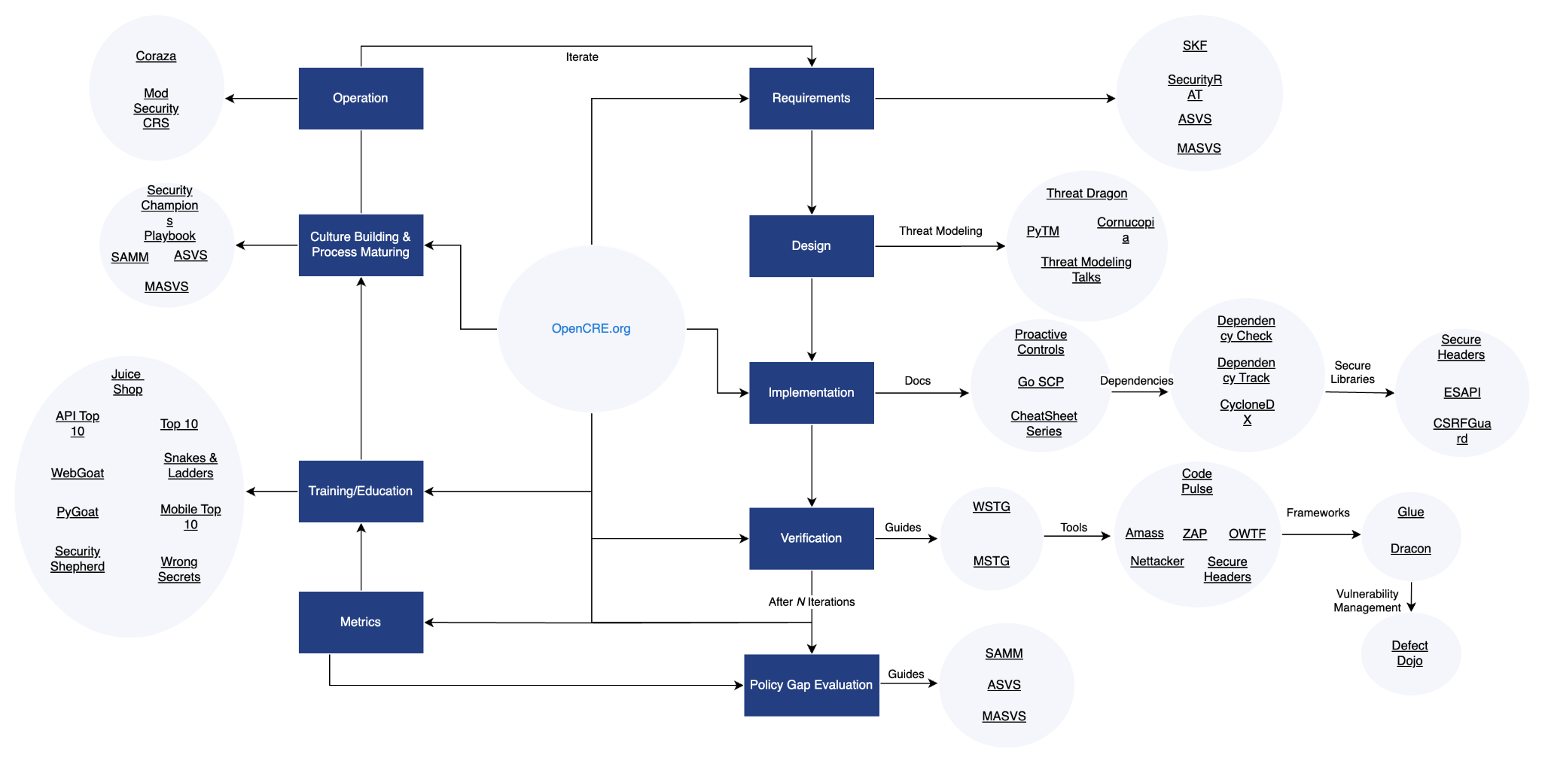
OWASP Projects
More than 300 projects
Code
Documentation
Other
All results are released under an open source license and usable in a commercial context for free.
Flagship & Production OWASP Projects

Slide 5

OWASP Top 10
The most well known OWASP project
Showcases the most important 10 application security risks
A de facto industry AppSec standard since its inception in 2003
Primarily an awareness document (don’t stop at 10)
(more on this will be presented by Marco)

Slide 6
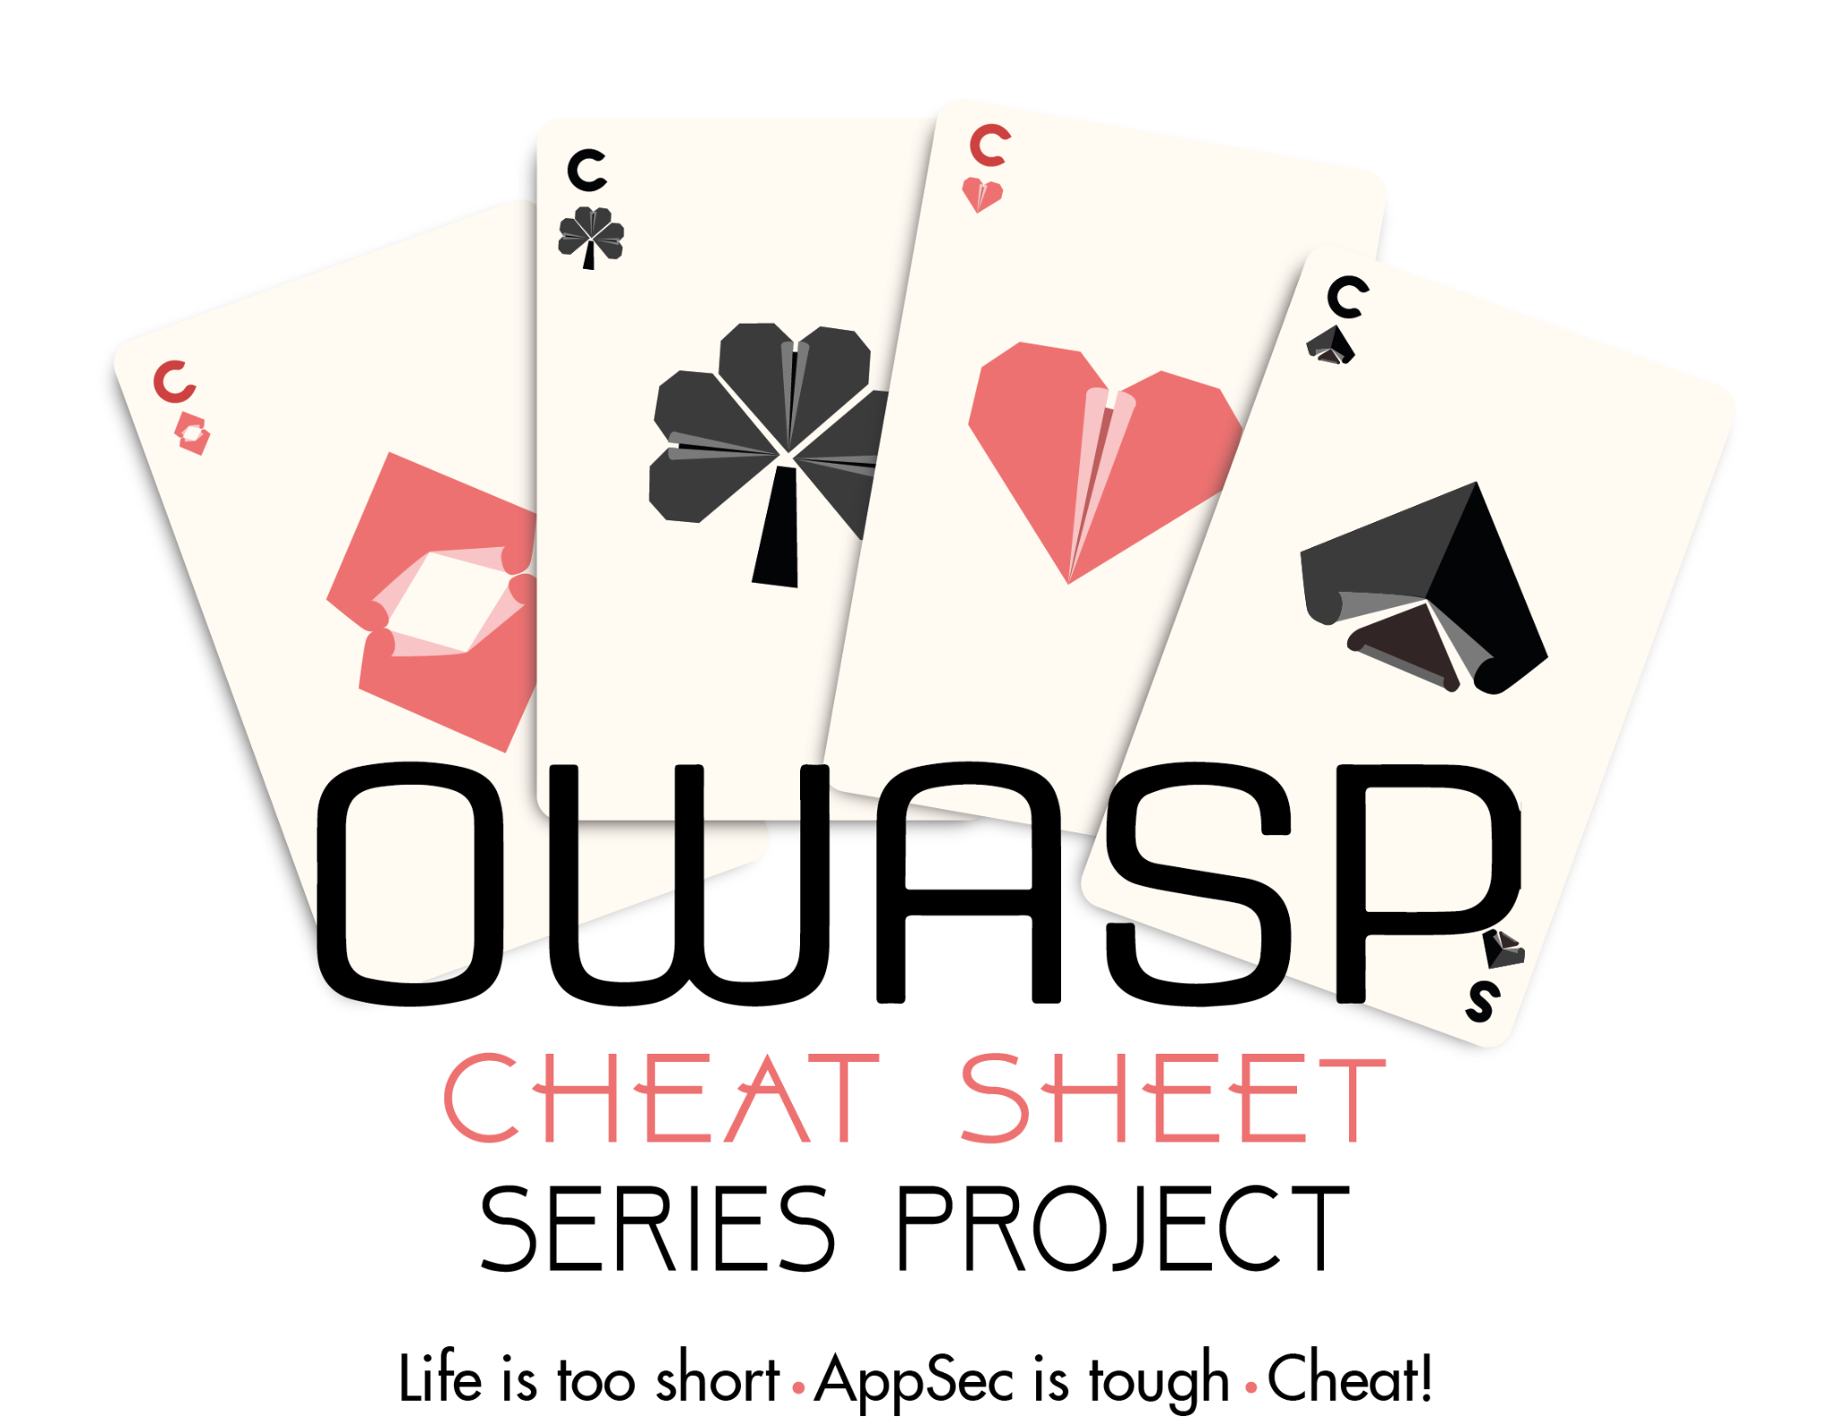
OWASP Cheat Sheet Series
A concise collection of high value information on specific application security topics
91 cheat sheets available
Authentication
Authorization
CI/CD Security
Docker Security
DotNet Security
Kubernetes Security
Logging
SAML Security
XML Security
….

Slide 7
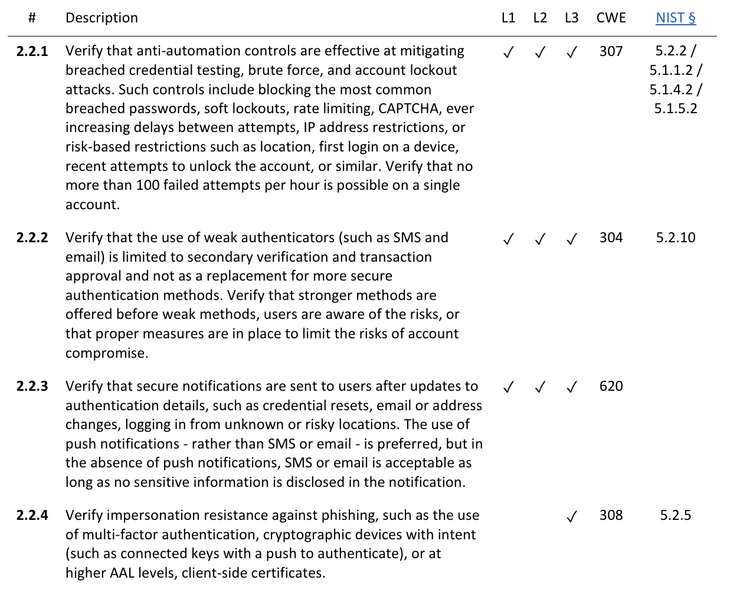
OWASP Application Security Verification Standard
Provides a basis for testing web application technical security controls and also provides developers with a list of requirements for secure development
Some example controls out of the OWASP ASVS

Slide 8
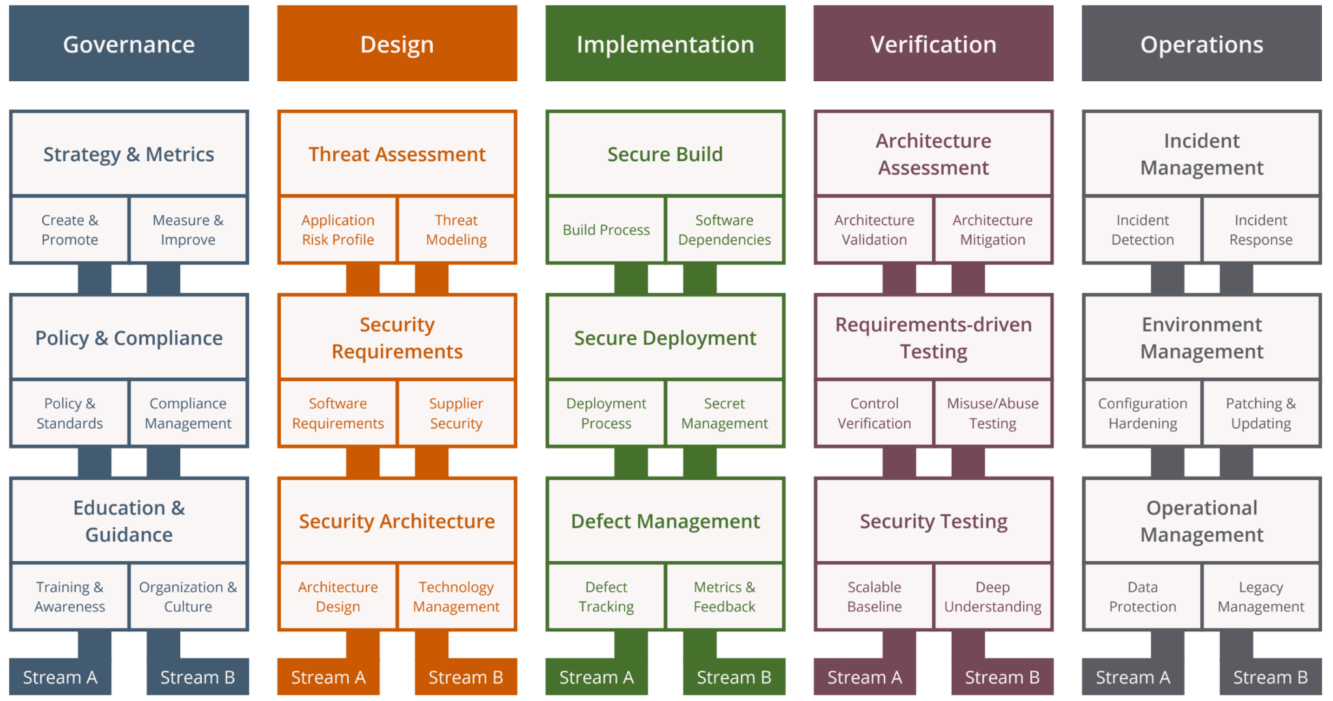
OWASP Software Assurance Maturity Model (SAMM)
Effective and measurable way for you to analyze and improve your secure development lifecycle
Technology and process agnostic
Helps you to build a balanced software security assurance program in well-defined iterations
Define and measure security-related activities throughout an organization

Slide 9

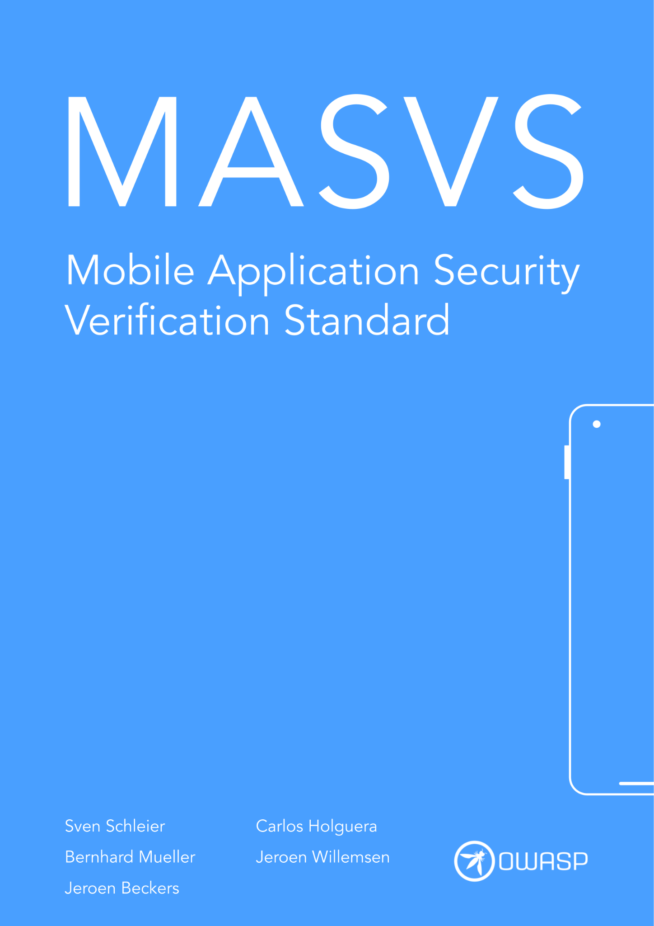
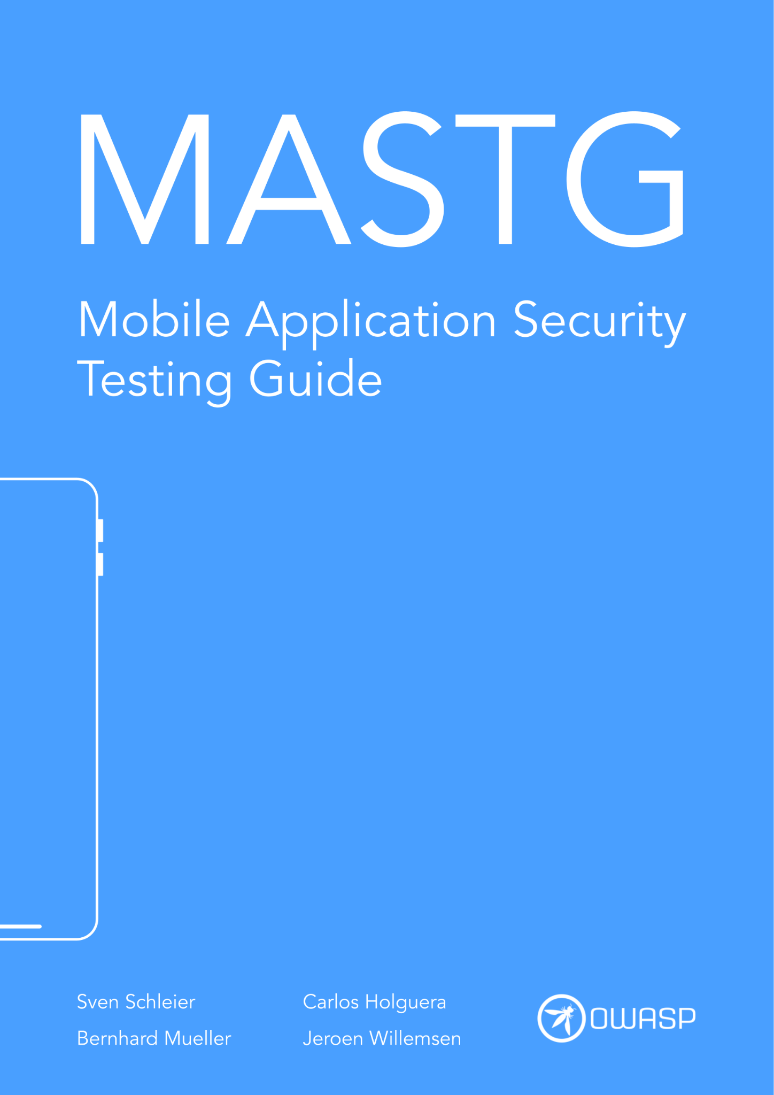
OWASP Mobile Application Security (MAS)
Security standard for mobile apps (OWASP MASVS)
and a
Comprehensive testing guide (OWASP MASTG)
(more on this will be presented by Stefan)
OWASP Mobile Application Security

Slide 10
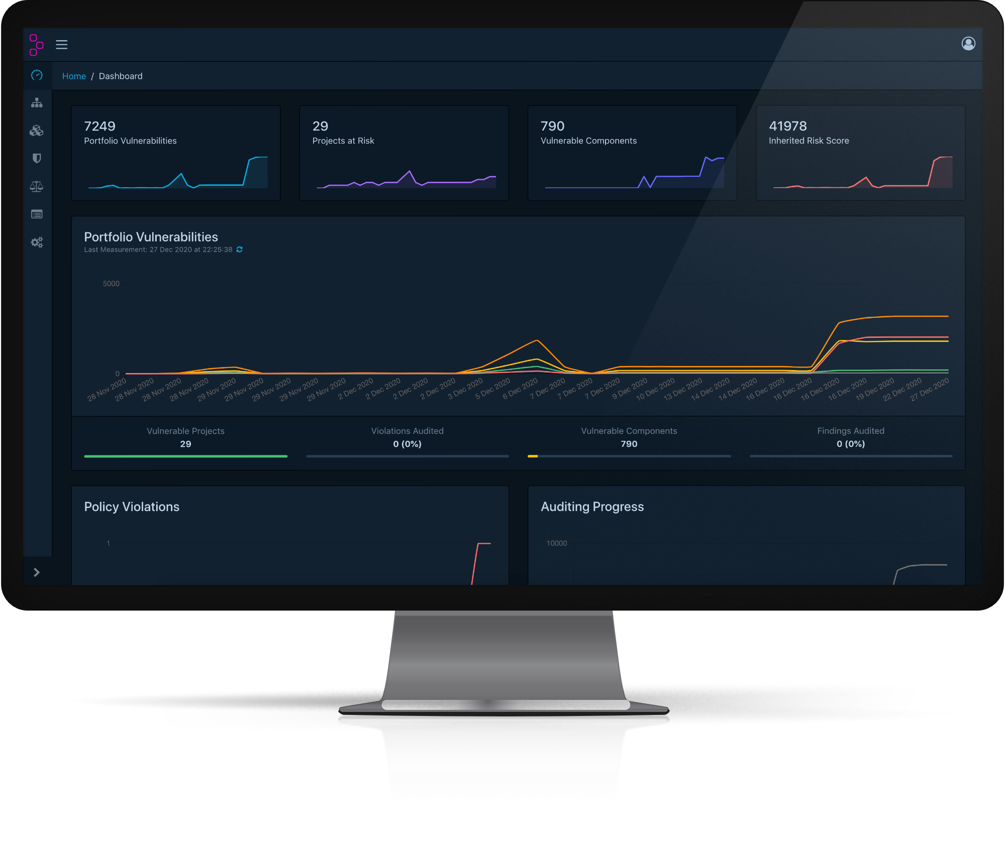
OWASP Dependency-Track
A component analysis platform that allows organizations to identify and reduce risk in the software supply chain. Dependency-Track helps you by making tracking of Software Bill of Materials (SBOM) a breeze.

Slide 11
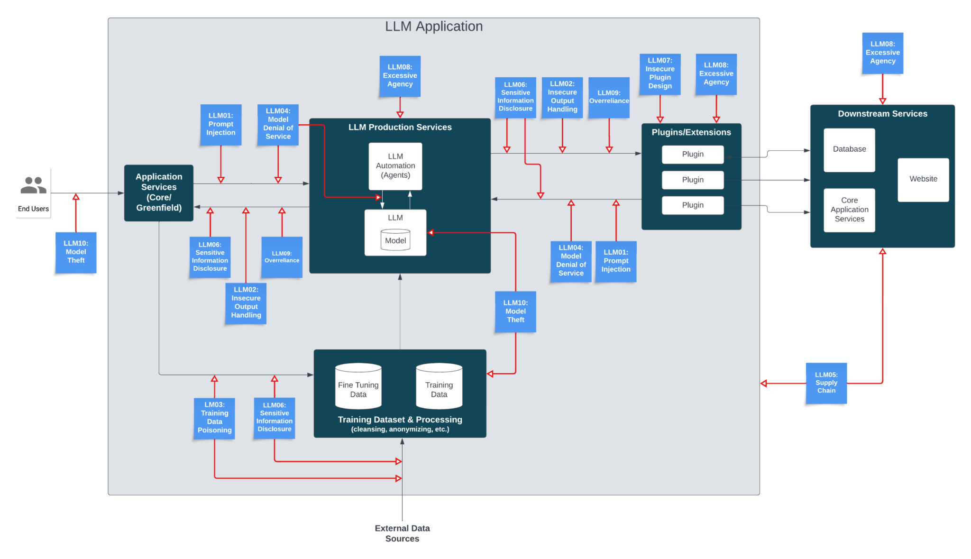
OWASP LLM Top 10
Latest Top 10 risks, vulnerabilities and mitigations for developing and securing generative AI and large language model applications across the development, deployment and management lifecycle
OWASP Top 10 for LLMs and Generative AI Apps

Slide 12
OWASP Switzerland
First mentioned in January 2005
First meeting in November 2006
On-site only meetings till the covid pandemic
Online-only meetings from the start of the covid pandemic until 2024
Since 2024 we are back to on-site meetings
Meet on-site in person.
Get to know your local community.
Exchange ideas with like minded people.
Contribute to the local network.
Dive into the global community.

Slide 13
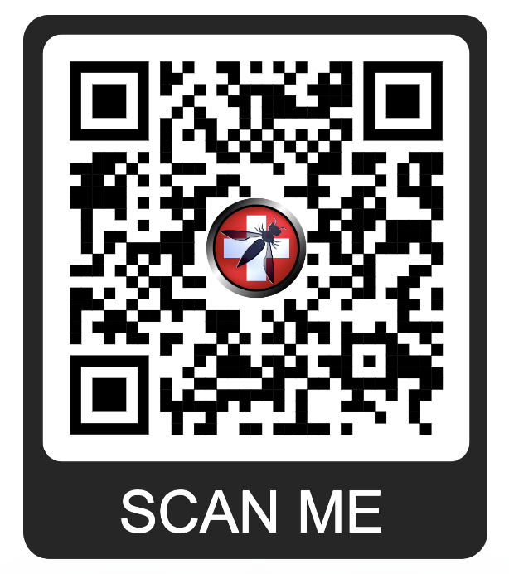
Become a Member
If you like what we do, please consider becoming an OWASP member.
$50/year for individuals
$500/lifetime
Starting $2,000/year for companies
https://owasp.org/membership/

Slide 14
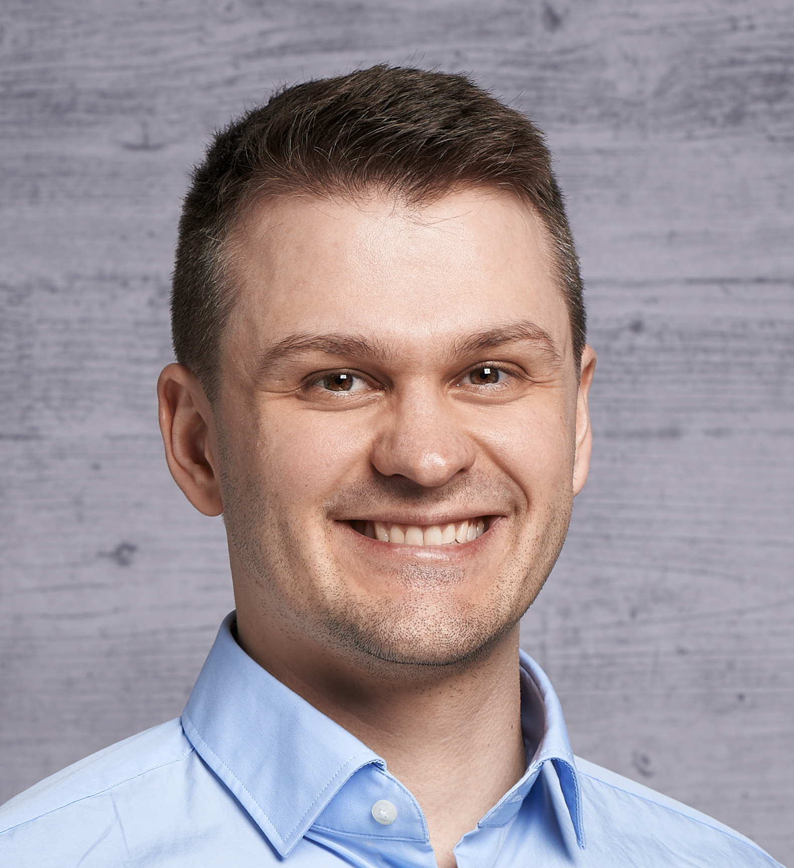
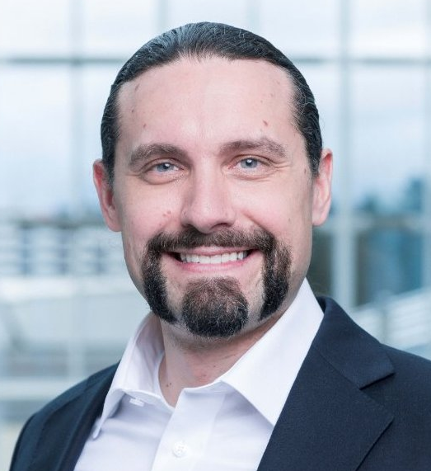
OWASP Switzerland Community Meetup
MEET OUR SPEAKERS
Thomas Sutter
Romano Roth
University of Bern
Zühlke Engineering
Uninstallable by Design
Continuous Security with DevSecOps

Slide 15




Meetup
https://www.meetup.com/OWASPSwitzerland/
Web
https://owasp.org/www-chapter-switzerland/
THANK YOU
FOR BEING PART OF OWASP
YouTube
https://www.youtube.com/@OWASPSwitzerland
X (formerly known as Twitter)
https://x.com/owasp_ch

